Slide 1
Laws of Logic

Slide 2
Outline
What are some of the laws of Logic?
-Law of Non-Contradiction
-Law of Identity
-Law of Rational Inference
-Law of the Excluded Middle

Slide 3
Intro to Laws of Logic

Slide 4
Do you understand the following verses…
¹⁵ And the Lord God took the man, and put him into the garden of Eden to dress it and to keep it.
¹⁶ And the Lord God commanded the man, saying, Of every tree of the garden thou mayest freely eat:
¹⁷ But of the tree of the knowledge of good and evil, thou shalt not eat of it: for in the day that thou eatest thereof thou shalt surely die.
Do you comprehend these verses: Yes / No

Slide 5
If you answered Yes, you are thinking, even if you answered No… You are still thinking (you are just a little slow :>)
You are thinking, and you are applying the basic laws that govern thought / reasoning.

Slide 6
You are conforming to basic laws of logic even if you do not realize it.
Without those basic laws in place we would not be able to think, reason or communicate properly. Or make sense of anything!
Already, at this point, (if you did not believe in reasoning / logic) you would have given up, because these few sentences would have been utterly meaningless to you.
Each word could have meant something totally different if you were not applying the laws of logic.

Slide 7
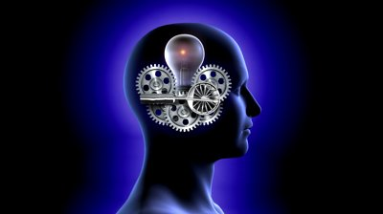
What are some of these “Laws”

Slide 8
Law of Non-Contradiction

Slide 9
Law of Non-Contradiction
This Law states that no statement can be both true and not true (false) at the same exact time.
This Law enables or allows our minds to figure out what is True and what is False
Truth / Lies
The law of non-contradiction is important because it’s how we tell the truth from a lie. Without it, it would be impossible to tell the difference..
A lie is that which contradicts the truth.

Slide 10
Example:
Suppose I tell you that my sister April is pregnant again, and then five minutes later, you come back to me and ask,
“Does your sister know if the baby is a boy or a girl?”
I then I reply, “My sister is not pregnant what are you talking about.”
What would you conclude from that?”
You would immediately conclude that I had lied to you, and rightly so.

Slide 11
She can’t be both pregnant and not pregnant at the same time and in the same sense, can she?”
The reason we know it’s a lie is because of the:
“Law of non-contradiction”.
Both statements cannot simultaneously be true because they directly contradict each other.

Slide 12
Hebrews 12
12 Wherefore seeing we also are compassed about with so great a cloud of witnesses, let us lay aside every weight, and the sin which doth so easily beset us, and let us run with patience the race that is set before us,
² Looking unto Jesus the author and finisher of our faith; who for the joy that was set before him endured the cross, despising the shame, and is set down at the right hand of the throne of God.
³ For consider him that endured such contradiction of sinners against himself, lest ye be wearied and faint in your minds.
In Jesus last days alone what contradictions did he have to endure?

Slide 13
For consider him that endured such contradiction of sinners against himself, lest ye be wearied and faint in your minds
Luke 22:47-49
Judas betrays Jesus him w/ a kiss – contradiction of character
John 18:37-38
Pilate saying he finds no fault in him, but then has Jesus scourged and crucified anyway…
Matthew 27:41-43
While Jesus is on the cross… “He saved others.. Himself he cant save…

Slide 14
Law of Identity

Slide 15
Law of Identity
The law of identity states that A is A.
An Apple is an Apple. In other words, something is what it is. If something exists, it has a nature, an essence. For example, a book has a front and back cover with pages. A car has four wheels, seats, doors, windows, etc. A tree has branches, leaves, a trunk, and roots. This also means that anything that exists has characteristics. We recognize what something is by observing its characteristic. You know that a tree is a tree because you see its branches, it's leads, its trunk, etc.
Furthermore, if something has an identity, it has a single identity. It does not have more than one identity. In other words, if something exists it has a set of attributes that are consistent with its own existence. It does not have a set of attributes that are inconsistent with itself. Therefore we can easily conclude that a cat is not a parachute. An Apple is not a race car. A tree is not a movie.

Slide 16
Law of Rational Inference

Slide 17
Law of rational inference
In the “Law of Rational Inference”, a truth is drawn from another idea that is supposed or admitted to be true.
A process of reasoning by which a fact or proposition sought to be established is deduced as a logical consequence from other facts, or a state of facts, already proved or admitted.
A logical and reasonable conclusion of a fact not presented by direct evidence but which, by process of logic and reason, a trier of fact may conclude exists from the established facts.
Inferences are deductions or conclusions that with reason and common sense leads a person to draw from facts, which have been established by the evidence in a case.
This Law of Rational Inference has a very close relationship with the concept of Faith…

Slide 18
Law of Excluded Middle
The law of excluded middle says that a statement is either true or false. For example, my hair is brown. It is either true or false that my hair is brown. Another example: I am pregnant. The statement is either true or false. Since I am a male, it is not possible for me to be pregnant. Therefore, the statement is false. If I were a female, it would be possible for me to be pregnant (given normal bodily conditions).
A woman is not "kind-of" pregnant. She either is or is not pregnant - there is no middle position. The law of excluded middle is important because it helps us deal in absolutes. This is particularly important in a society where relativism is promoted and truth statements are denied.

Slide 19
Law of Identity
Law of Rational Inference
Law of Non-Contradiction
Law of Excluded Middle
We use them every day without thinking twice. They are “2nd nature” They are a built in part of our being.
Example:

Slide 20
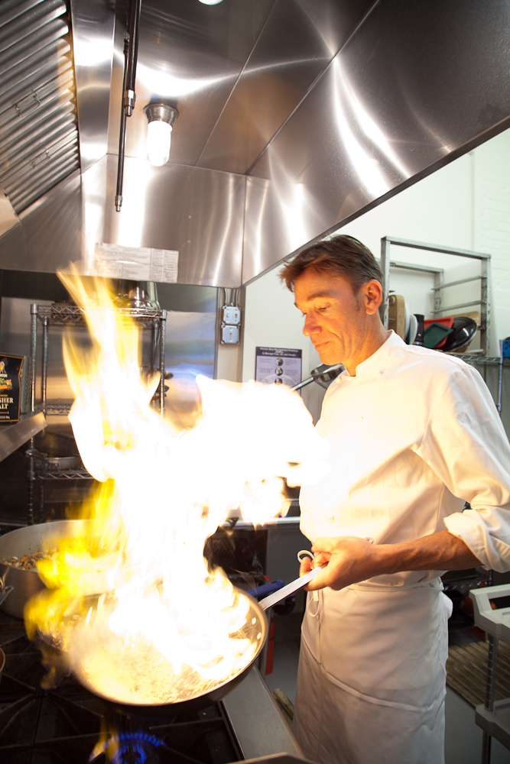
Everyday – Truths we take for granted.
Law of Identity:
The Chef, Chef’s hand, Pan, Oven etc
Law of Rational Inference
The man reasons: This pan is very hot so I’ll grab the handle!
The Law of Non-Contradiction
The chef knows all to well that if he does not respect the top 2 laws he will test the Law of Non-contradiction and find out that the frying pan is not both hot and cold, but hot and burn himself.
The truth here is the pan is hot – its undeniable. That’s why there is a handle.

Slide 21
What are the Laws of Logic?
They are: Immaterial, universal, invariant, abstract entities, which govern all possible conceptual relationships.
They govern / regulate reasoning in your head.
These Laws help us get to the Truth of the Matter!
Laws of Logic make sense in the Christian World view.
An Atheist's world view can’t rationally account for them….

Slide 22
Truth

Slide 23
Truth
the true or actual state of a matter: He tried to find out the truth.
2. conformity with fact or reality; verity: the truth of a statement.
3. a verified or indisputable fact, proposition, principle, or the like: mathematical truths.
4. the state or character of being true.
5. actuality or actual existence.

Slide 24
Pilate – What is “Truth”?
John 18:37-39
³⁷ Pilate therefore said unto him, Art thou a king then? Jesus answered, Thou sayest that I am a king. To this end was I born, and for this cause came I into the world, that I should bear witness unto the truth. Every one that is of the truth heareth my voice.
³⁸ Pilate saith unto him, What is truth? And when he had said this, he went out again unto the Jews, and saith unto them, I find in him no fault at all.

Slide 25
Truth- Strongs Concordance # H571
1) firmness, faithfulness, truth
a) sureness, reliability
b) stability, continuance
c) faithfulness, reliableness
d) truth
1) as spoken
2) of testimony and judgment
3) of divine instruction
4) truth as a body of ethical or religious knowledge
5) true doctrine

Slide 26
Genesis 42:16
Send one of you, and let him fetch your brother, and ye shall be kept in prison, that your words may be proved, whether there be any truth in you: or else by the life of Pharaoh surely ye are spies.

Slide 27
Ephesians 6:14 Stand therefore, having your loins girt about with truth, and having on the breastplate of righteousness;
Truth is part of the whole armour of God we are supposed to be wearing

Slide 28
Where does Truth Come From?
Deuteronomy 32:3-5
³ Because I will publish the name of the Lord: ascribe ye greatness unto our God.
⁴ He is the Rock, his work is perfect: for all his ways are justice, a God of truth and without iniquity, just and right is he.
Exodus 34:6
6 Then the Lord passed by in front of him and proclaimed, “The Lord, the Lord God, compassionate and gracious, slow to anger, and abounding in loving kindness and truth;

Slide 29
Numbers 23:19
19 “ªGod is not a man, that He should lie,
Nor a son of man, that He should repent;
Has He said, and will He not do it?
Or has He spoken, and will He not make it good?
Psalm 19:9
9 The fear of the Lord is clean, enduring forever;
The judgments of the Lord are true; they are righteous altogether.
Isaiah 25:1
1 O Lord, You are my God;
I will exalt You, I will give thanks to Your name;
For You have worked wonders,
Plans formed long ago, with perfect faithfulness.
2 Tim 2:13…”God cannot deny himself”

Slide 30
Daniel 4:37
37 “Now I, Nebuchadnezzar, praise, exalt and honor the King of heaven, for all His works are true and His ways just, and He is able to humble those who walk in pride.”
John 17:17
17 “Sanctify them in the truth; Your word is truth.
James 3 17
But the wisdom from above is first pure, then peaceable, gentle, reasonable, full of mercy and good fruits, unwavering, without hypocrisy.
Psalm 33:4 For the word of the LORD is right; and all his works are done in truth.
Psalm 119:142 Thy righteousness is an everlasting righteousness, and thy law is the truth.

Slide 31
Titus 1:1-3
1 Paul, a servant of God and an apostle of Jesus Christ, for the sake of the faith of God's elect and their knowledge of the truth, which accords with godliness,
² in hope of eternal life, which God, who never lies, promised before the ages began
³ and at the proper time manifested in his word through the preaching with which I have been entrusted by the command of God our Savior;

Slide 32
We are made in Gods “Image”
(the image of the Angels)
Image means:
likeness (of resemblance), semblance
God gave us a Brain so we could use it! He gave our brains guidelines so our brains would think clearly, logically and spiritually.
It is not said of all the other animals that God made, that they were made in the image of the Elohim – this is what sets man apart from the beasts… we are a special creation.

Slide 33
Gen 2:
¹⁶ And the Lord God commanded the man, saying, Of every tree of the garden thou mayest freely eat:
¹⁷ But of the tree of the knowledge of good and evil, thou shalt not eat of it: for in the day that thou eatest thereof thou shalt surely die.

Slide 34
What did Adam & Eve have to Know here? As it relates to this class?
They had to know (or pre-suppose) the following (not academically) but consciously or subconsciously – otherwise God’s commandment to them would not of made sense…
Law of Identity
Law of rational Inference
Law of non-contradiction
Law of Excluded middle

Slide 35
Adam had to know: who he was, who God was, what the garden was, where that tree was, what a tree was, what the fruit was.
This is the Law of Identity
These “things” would not make any sense to Adam or Eve if they didn’t already know who and what they were.

Slide 36
They also had to understand Gods Command:
“But of the tree of the knowledge of good and evil, thou shalt not eat of it.”
They had to understand that in order to eat the fruit, Adam or Eve would have to walk up to the tree, grab and pick the fruit, put it in their mouths and chew and swallow it.
They also knew that if they did this, there was a punishment for disobedience …. they would shalt surely die. (dying thou shalt die)
This is the law of Rational Inference
The Law of Rational Inference
In order to reach that conclusion (Death) they would of used the Law of Rational Inference – Understanding Gods law concerning that tree… if you eat it, = “dying thou shalt die”

Slide 37
These are part of the:
Law of Non-Contradiction
– they would have to know that breaking Gods commandment would be contradicting what God Commanded.
Obedience kept the commandment.
Disobedience would prove a contradict what God Commanded

Slide 38
How do we know Adam / Eve understood these concepts
We know that Adam understood these ideas by what he told Eve:
Eve told this to the Serpent (remember God gave his commandment directly to Adam, Eve was not formed yet)
Gods original commandment to Adam was… “¹⁷ But of the tree of the knowledge of good and evil, thou shalt not eat of it: for in the day that thou eatest thereof thou shalt surely die.”
Here is Eve repeating the commandment to the Serpent with a little Extra in it:
³ But of the fruit of the tree which is in the midst of the garden, God hath said, Ye shall not eat of it, neither shall ye touch it, lest ye die.”
Gods commandment to Adam saying nothing about Touching the Fruit.
I would submit to you that when Adam told Eve of the commandment he added an extra line, because he thought it through in his head, that in order to eat the fruit, you first had to touch the fruit. So just to make it absolutly clear to Eve, he didn’t even wanting her touching it (he thought it through)
Or Eve thought it through for herself and see added the extra command…

Slide 39
The Laws of Logic, Rational thought and any type of Argumentation are contingent upon the Biblical God – They make sense in the Christian World view. God is the source of all knowledge.
An atheist's worldview can’t account for them… If you are a naturalist… there is no room for Logic or Laws of Logic in your worldview, if nature is all that there is.

Slide 40
To put it another way: Imagine the critic of words.
He says “I don’t believe in words. Prove to me that that words exist without using words…
Your Retort:
Well, I don’t accept your standards that words don’t exist, and you just used Words to tell me that words don’t exist, cant you see how silly you are being?

Slide 41
Colossians 2:3
² That their hearts might be comforted, being knit together in love, and unto all riches of the full assurance of understanding, to the acknowledgement of the mystery of God, and of the Father, and of Christ;
³ In whom are hid all the treasures of wisdom and knowledge.
Proverbs 1:7 The fear of the LORD is the beginning of knowledge: but fools despise wisdom and instruction.
What I am trying to demonstrate is that without God, nothing would make any sense at all. We would just be chemical accidents acting out the works of chemistry.
There would be no such thing as any kind of Truth, any kind of Morality (right & wrong, Good & Evil), any kind of Reasoning, and any kind of Purpose in this life.
But we have all those things don’t we!!!!
With God in your worldview all these concepts ALL MAKE PERFECT SENSE!

Slide 42
Rom 1:
¹⁸ For the wrath of God is revealed from heaven against all ungodliness and unrighteousness of men, who by their unrighteousness suppress the truth.
¹⁹ For what can be known about God is plain to them, because God has shown it to them. ²⁰ For his invisible attributes, namely, his eternal power and divine nature, have been clearly perceived, ever since the creation of the world, in the things that have been made. So they are without excuse.
²¹ For although they knew God, they did not honor him as God or give thanks to him, but they became futile in their thinking, and their foolish hearts were darkened.
²² Claiming to be wise, they became fools, ²³ and exchanged the glory of the immortal God for images resembling mortal man and birds and animals and creeping things.²⁴ Therefore God gave them up in the lusts of their hearts to impurity, to the dishonoring of their bodies among themselves, ²⁵ because they exchanged the truth about God for a lie and worshiped and served the creature rather than the Creator, who is blessed forever! Amen.

